Slide 1
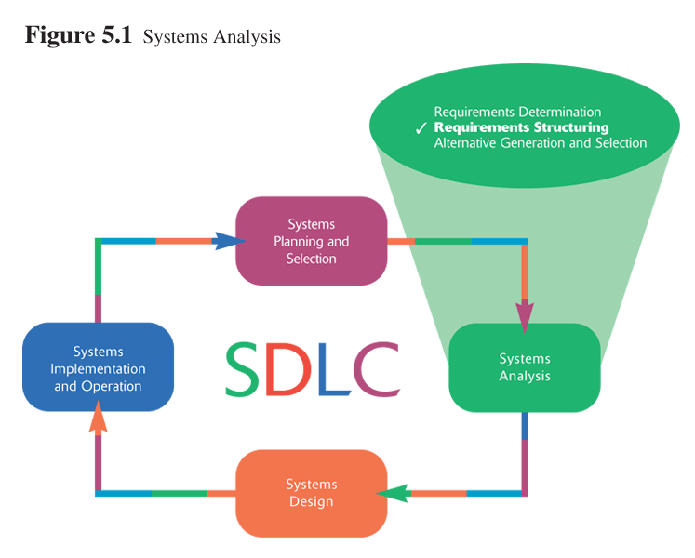
BAD 2014
ANALYSIS AND DESIGN
OF E-COMMERCE SYSTEMS
6

Slide 2
BAD 2014
ANALYSIS AND DESIGN
OF E-COMMERCE SYSTEMS
Lesson – 6
System analysis
b. Structuring System Requirements:
Process Modeling
(Chpter 5)

Slide 3
Requirements structuring
Requirements structuring is the second of the three primary analysis phases.
This chapter introduces us to two methods useful for structuring requirements: process modeling and logic modeling
The focus of this session will be on a tool analysts use to structure information – data flow diagrams (DFDs).
DFD allow us to model how data flow through an information system, the relationship among the data flows and how data to be stored at specific locations.
DFD also show the processes that transforms data. Because DFD concentrates on the movement of data between processes, the diagrams are called process models.
In this lesson we will learn the mechanics of drawing and revising data flow diagrams and also learn two important concepts related to data flow diagrams: balancing and decomposition.

Slide 4
Process Modeling

Slide 5
Process Modeling
Graphically represent the processes that capture, manipulate, store and distribute data between a system and its environment and among system components
Data flow diagrams (DFD)
  Graphically illustrate movement of data between external entities and the processes and data stores within a system
Modeling a system’s process
  Utilize information gathered during requirements determination
  Structure of the data is also modeled in addition to the processes

Slide 6
Process Modeling (continued)
Deliverables and outcomes
  Context data flow diagram (DFD)
    Scope of system
  DFDs of current system
    Enables analysts to understand current system
    Project dictionary and CASE repository
  DFDs of new logical system
    Technology independent
    Show data flows, structure and functional requirements of new system
  Through description of each DFD component

Slide 7
Data Flow Diagramming

Slide 8

Data Flow Diagramming Mechanics
Data Flow
  Depicts data that are in motion and moving as a unit from one place to another in the system
  Drawn as an arrow
  Select a meaningful name to represent the data

Slide 9
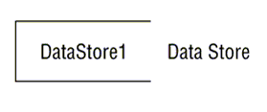
Data Flow Diagramming Mechanics
Data Store
  Depicts data at rest
  May represent data in:
    File folder
    Computer-based file
  Drawn as a rectangle with the right hand vertical line missing
  Label includes name of the store as well as the number

Slide 10
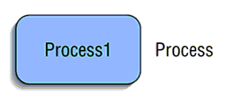
Data Flow Diagramming Mechanics
Process
  Depicts work or action performed on data so that they are transformed, stored or distributed
  Drawn as a rectangle with rounded corners
  Number of process as well as name are recorded

Slide 11
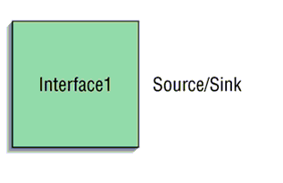
Data Flow Diagramming Mechanics
Source/Sink
  Depicts the origin and/or destination of the data
  Sometimes referred to as an external entity
  Drawn as a square symbol
  Name states what the external agent is
  Sources / sinks are always outside the information system and define the system’s boundaries.
  Because they are external, many characteristics are not of interest to us

Slide 12
Data Flow Diagramming Definitions
Context Diagram
  A data flow diagram (DFD) of the scope of an organizational system that shows the system boundaries, external entities that interact with the system and the major information flows between the entities and the system
Level-O Diagram
  A data flow diagrams (DFD) that represents a system’s major processes, data flows and data stores at a higher level

Slide 13
Data Flow Diagramming Definitions
Context Diagram
  A data flow diagram (DFD) of the scope of an organizational system that shows the system boundaries, external entities that interact with the system and the major information flows between the entities and the system
  All the context diagrams have only one process labeled “0”.

Slide 14
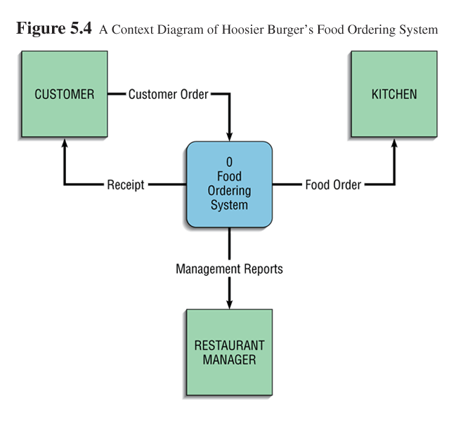
Developing DFDs: An Example
The context diagram contains only one process labeled “0” and no data stores, four data flows, and three sources/sinks.

Slide 15
Example (cont..)
After the context diagram, the next step for the analyst is to think about which processes are represented in the single process shown in the context diagram.
In this example, We can identify four separate processes, providing more detail.
The level-0 diagram represents a system’s major processes, data flows, and data stores at a high level of detail, as shown in the next slide

Slide 16
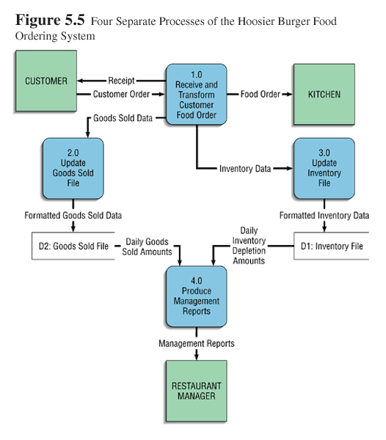
Capturing data from different sources (process 1.0)
Maintaining data stores (process 2.0 and 3.0)
Producing and distributing data to different sinks (process 4.0)
High-level descriptions of data transformation operations (process 1.0)

Slide 17
the system begins with an order from customer, as was the case with the context diagram.
In the first process, labeled “1.0”, we see that the customer order is processed.
The results are four streams or flows of data:
  1 the food order is transmitted to the kitchen,
  2 the customer order is transformed in to a list of goods sold,
  3 the customer order is transformed into inventory data and
  4 the process generates a receipt for the customer.

Slide 18
Whenever Process 1.0 produces this flow. Process 3.0 must be ready to accept it. Thus, Processes 1.0 and 3.0 are coupled to each other.
In contrast, consider the link between Process 2.0 and Process 4.0. The output from Process 2.0, Formatted Goods Sold Data, is placed in a data store and later, when Process 4.0 needs such data, it reads Daily Goods Sold Amounts from this data store.
In this case, Processes 2.0 and 4.0 are decoupled by placing buffer, a data store

Slide 19
Data Flow Diagramming Rules
Basic rules that apply to all DFDs
  Inputs to a process are always different than outputs
  Objects always have a unique name
    In order to keep the diagram uncluttered, you can repeat data stores and data flows on a diagram

Slide 20
Data Flow Diagramming Rules
Process
  No process can have only outputs (a miracle)
  No process can have only inputs (black hole)
  A process has a verb phrase label
Data Store
  Data cannot be moved from one store to another
  Data cannot move from an outside source to a data store
  Data cannot move directly from a data store to a data sink
  Data store has a noun phrase label

Slide 21
Data Flow Diagramming Rules
Source/Sink
  Data cannot move directly from a source to a sink
  A source/sink has a noun phrase label
Data Flow
  A data flow has only one direction of flow between symbols
  A fork means that exactly the same data go from a common location to two or more processes, data stores or sources/sinks

Slide 22
Data Flow Diagramming Rules
Data Flow (Continued)
  A join means that exactly the same data come from any two or more different processes, data stores or sources/sinks to a common location
  A data flow cannot go directly back to the same process it leaves
  A data flow to a data store means update
  A data flow from a data store means retrieve or use
  A data flow has a noun phrase label

Slide 23
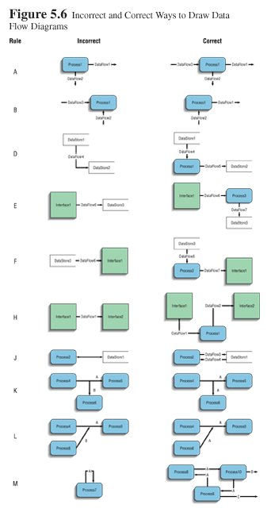

Slide 24
Decomposition of DFDs
&
Balancing DFDs

Slide 25
Decomposition of DFDs
Decomposition is the iterative process by which a system description is broken down into finer and finer detail, creating a set of diagrams in which one process on a given diagram is explained in greater detail on a lower–level diagram.
Functional decomposition
  Act of going from one single system to many component processes
  Repetitive procedure
  Lowest level is called a primitive DFD
Level-N Diagrams
  A DFD that is the result of n nested decompositions of a series of subprocesses from a process on a level-0 diagram

Slide 26
Balancing DFDs
When decomposing a DFD, you must conserve inputs to and outputs from a process at the next level of decomposition
You can determine if a set of DFDs are balanced or not by observing whether or not a process that appears in a level-n diagram has the same inputs and outputs when decomposed for a lower-level diagram.

Slide 27
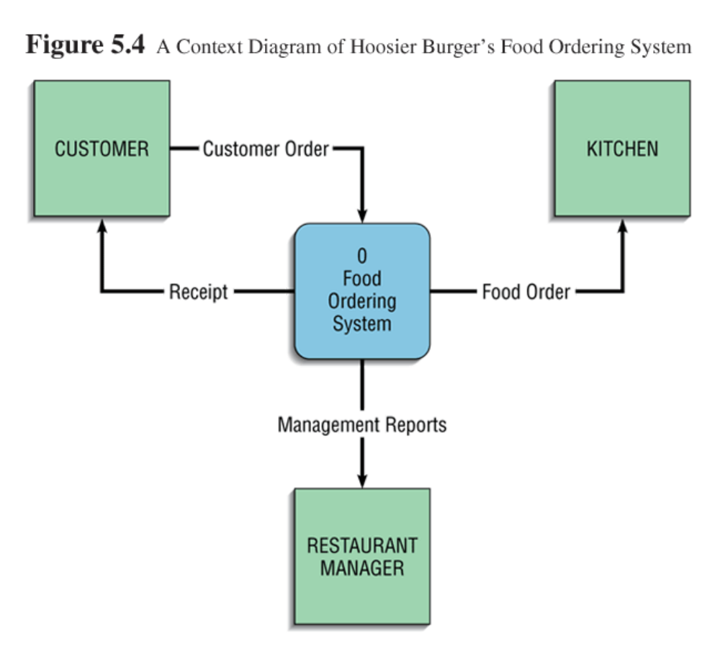
Example: Hoosier Burgers
  In Figure 5-4, notice that there is one input to the system, the customer order
  Three outputs:
    Customer receipt
    Food order
    Management reports

Slide 28


Slide 29
Balancing DFDs
Example (Continued)
  Notice previous Figure 5-5. We have the same inputs and outputs
  No new inputs or outputs have been introduced
  We can say that the context diagram and level-0 DFD are balanced

Slide 30
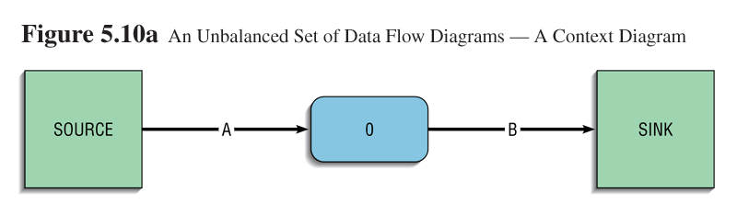
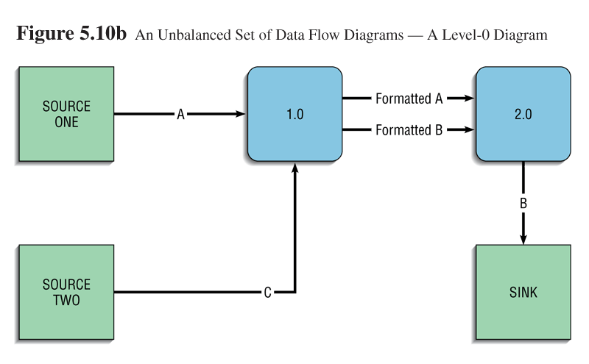
Balancing DFDs:
An Unbalanced Example
  In context diagram, we have one input to the system, A and one output, B
  Level-0 diagram has one additional data flow, C
  These DFDs are not balanced

Slide 31
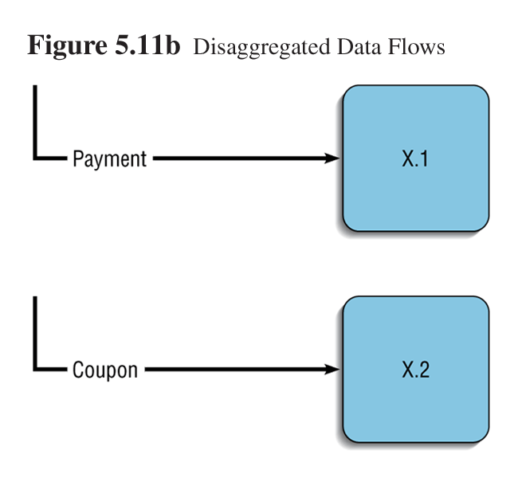
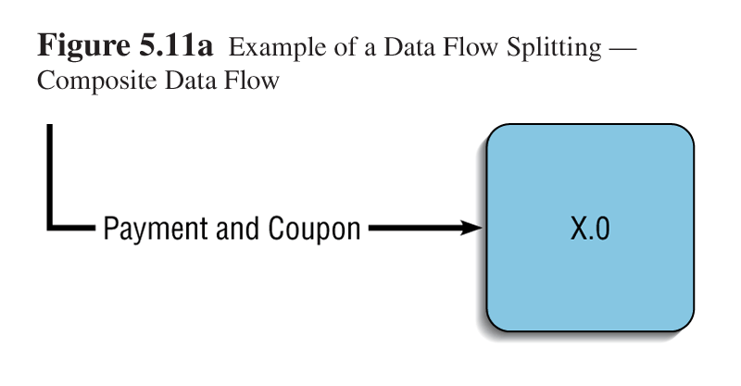
Balancing DFDs
We can split a data flow into separate data flows on a lower-level diagram

Slide 32
Guidelines for Drawing DFDs
  In addition to drawing DFDs that are mechanically correct, you must be concerned about whether the DFDs are complete and consistent across levels. Now on we will consider how we can use them as a tool for analysis.
  Completeness, consistency, timing considerations, the iterative nature of drawing DFDs, and drawing primitive DFDs are five additional data flow diagramming guidelines.

Slide 33
Guidelines for Drawing DFDs
Completeness
  DFD must include all components necessary for system
  Each component must be fully described in the project dictionary or CASE repository
Consistency
  The extent to which information contained on one level of a set of nested DFDs is also included on other levels
Timing
  Time is not represented well on DFDs
  Best to draw DFDs as if the system has never started and will never stop
Iterative Development
  Analyst should expect to redraw diagram several times before reaching the closest approximation to the system being modeled
Primitive DFDs
  Lowest logical level of decomposition
  Decision has to be made when to stop decomposition

Slide 34
Guidelines for Drawing DFDs
Rules for stopping decomposition
  When each process has been reduced to a single decision, calculation or database operation
  When each data store represents data about a single entity
  When the system user does not care to see any more detail

Slide 35
Guidelines for Drawing DFDs
Rules for stopping decomposition (continued)
  When every data flow does not need to be split further to show that data are handled in various ways
  When you believe that you have shown each business form or transaction, online display and report as a single data flow
  When you believe that there is a separate process for each choice on all lowest-level menu options

Slide 36
Using DFDs as Analysis Tools
Data flow diagrams are useful for performing gap analysis and for identifying system inefficiencies.
Gap analysis is the process of discovering discrepancies between two or more sets of data flow diagrams or discrepancies within a single DFD.
Gap analysis helps identify
  redundant data flows,
  data that are captured and not used by the system, and
  data that are updated identically in more than one location.
CASE tools aid in this analysis.

Slide 37
Logic Modeling

Slide 38
Logic Modeling
Although data flow diagrams are very good for identifying processes, they do not show the logic inside the processes. We must use other techniques to identifying processes.
Logic modeling involves representing internal structure and functionality of processes depicted on a DFD.
Processes must be clearly described before they can be translated into a programming language.
two popular methods for modeling system logic are.
  Structured English
  Decision Tables

Slide 39
Modeling Logic with Structured English
Structured English is a modified form of the English language used to specify the logic of information system processes,.
Structured English uses strong action verbs (read, write, print and sort) and noun phrases, but does not use adjectives or adverbs
The whole point of using Structured English is to represent processes in a short hand manner that is relatively easy for users and programmers to read and understand.

Slide 40
Structured English represents the three programming constructs :
  Sequence,
  Conditional (if-else, if, and switch statements)
  Iterative statements (while, do-while, and for)
Similar to programming language
  If conditions
  Case statements
EXAMPLE
BEGIN IF
IF QUANTITY-IN-STOCK is less than MINIMUM-ORDER-QUANTITY
THEN GENERATE new-order
ELSE DO nothing
END IF

Slide 41
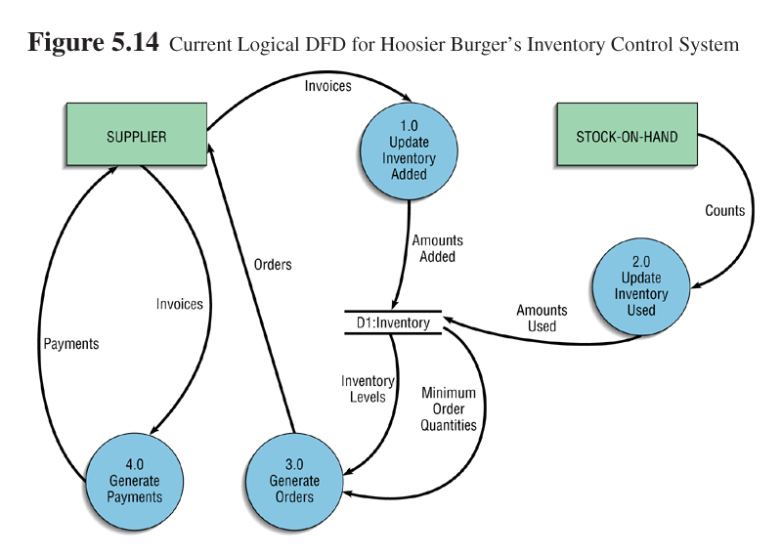

Slide 42
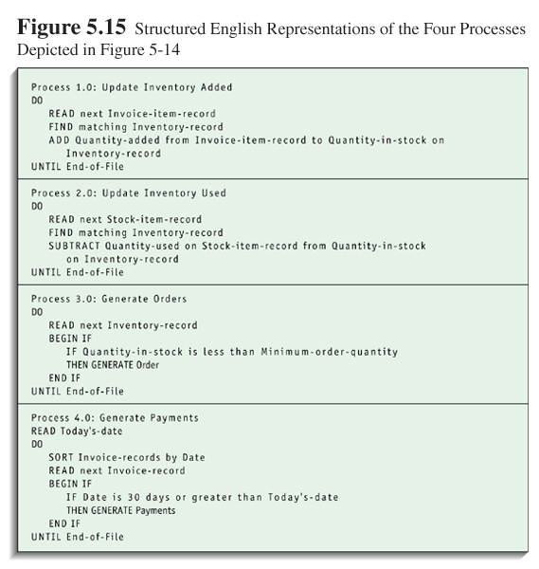

Slide 43
Modeling Logic with
Decision Tables
In many instances, Decision Logic is quite complex, and often Decision Tables are better suited for these situations.
Decision Tables are matrix representation of the logic of a decision
Specifies the possible conditions and the resulting actions

Slide 44
Modeling Logic with
Decision Tables
Consists of three parts
  Condition stubs
    Lists condition relevant to decision
  Action stubs
    Actions that result for a given set of conditions
  Rules
    Specify which actions are to be followed for a given set of conditions

Slide 45
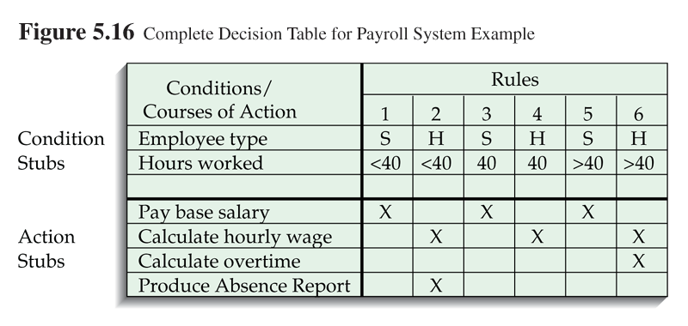

Slide 46
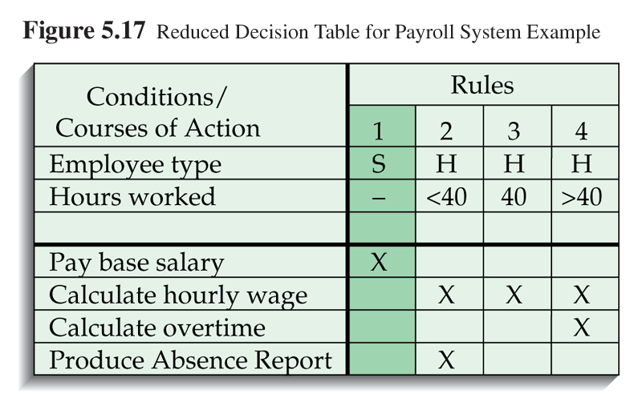
Indifferent Condition
  Because of the indifferent conditions for rule 1,3 & 5, we can reduce the number of rules by condensing rules 1,3 and 5 into one rule shown in fig 5-17. The indifferent condition is represented with dash. We now have a simpler table that conveys the same in with only four rules.

Slide 47
Modeling Logic with
Decision Tables
Standard procedure for creating decision tables
  Name the condition and values each condition can assume
    Limited Entry (simple Yes or No) Vs Extended Entry (Figure 5-16)
  Name all possible actions that can occur
  List all rules : When you first create a decision Table, you have to create an exhaustive set of rules. Every possible combination of conditions must be represented. Later you can identify the indifferent rules and remove them
  Define the actions for each rule (See Figure 5-18)
  Simplify the table (See Figure 5-19)

Slide 48
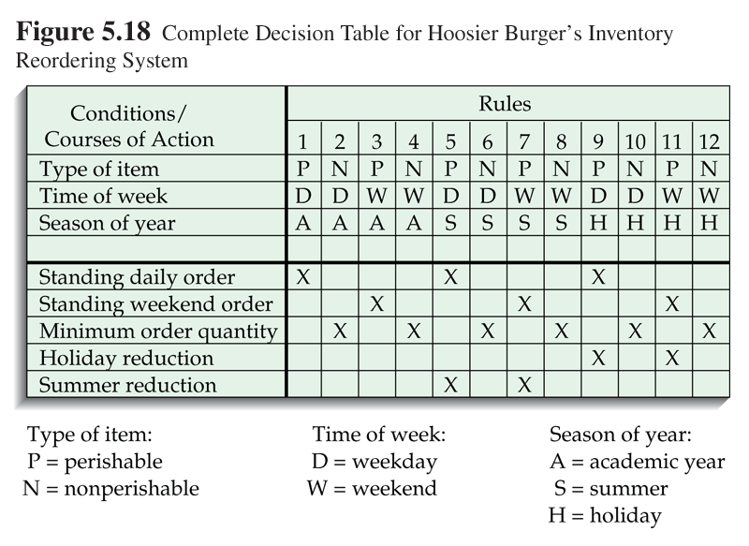

Slide 49
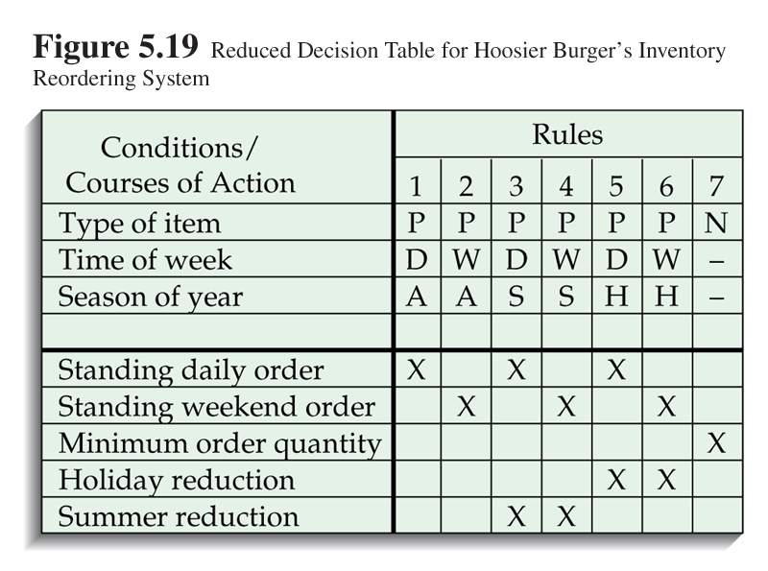

Slide 50
Process Modeling for
Electronic Commerce Application
Process modeling for electronic commerce projects is no different than other projects
  Pine Valley Furniture example WILL BE DISCUSSED IN THE UPCOMING TUTORIAL – DON’T MISS

